Slide 1
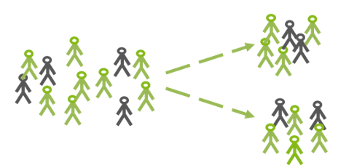
RANDOMIZED TRIALS II
José Manuel Arencibia Alemán & Isa Steinmann
Session 4
Source: Steinman, I. (2022) (Session 2 slides)

Slide 2

Last session’s take-away messages
Group comparisons are, in general, “fruitless comparisons” due to selection bias.
Randomized Control Trials allow us to get rid of selection bias but require samples to be representative and large enough.
Even after a “successful” RCT, we have to be aware of possible threats to validity.

Slide 3
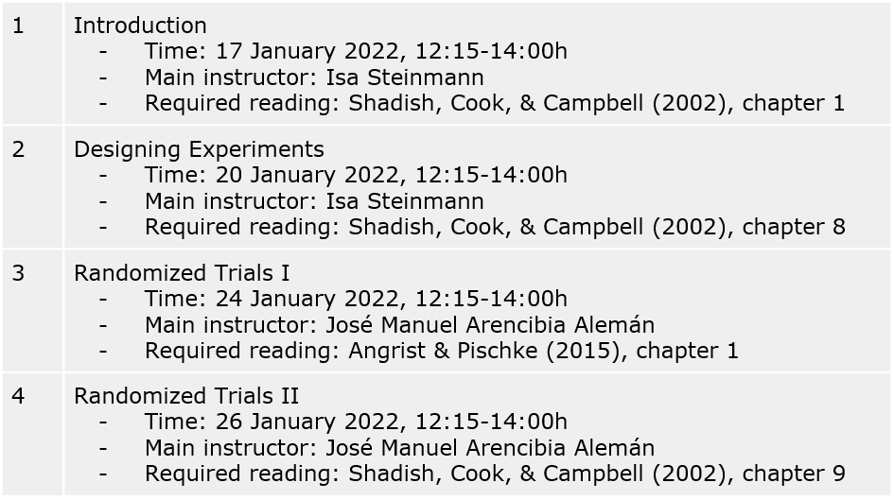

Slide 4
Session’s learning goal
Familiarize ourselves with the more practical, less formal, aspects of RCT. That is, how to guarantee that RCT are ethical and effective.
Notes:
In contrast to the previous session, this one deals with little formalizations and more with intuitive/theoretical aspects.

Slide 5

Content
Ethical Issues with Experiments
Withholding a Potentially Effective Treatment
The Ethics of Random Assignment
Recruitment Issues
Definition and Location
Willingness and Eligibility
Random Assignment Implementation
Methods of Randomization
Differences in Pretest Means
The Human Side of Random Assignment
Photo by Taneli Lahtinen on Unsplash
Notes:
In contrast to the previous session, this one deals with little formalizations and more with intuitive/theoretical aspects.

Slide 6
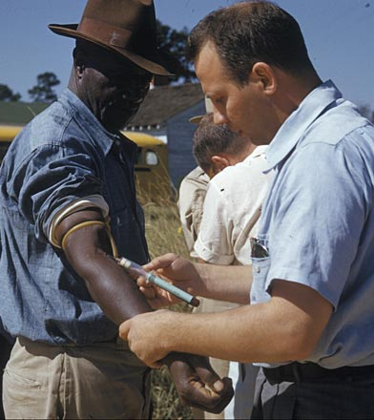
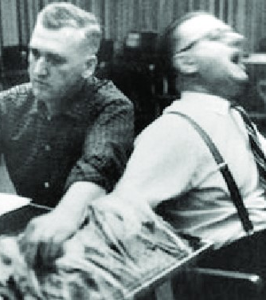
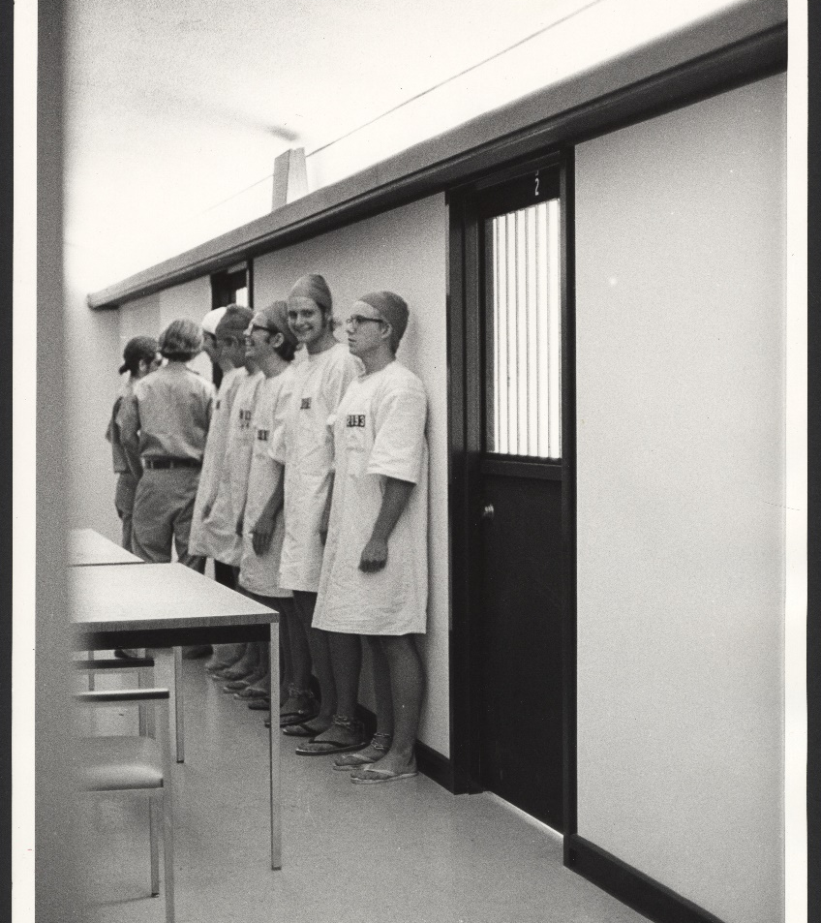
Ethical Issues with Experiments
Tuskegee Syphilis Study (1932-1972)
Milgram Experiment (1963)
Stanford Prison Experiment (1971)
Source: Centers for Disease Control and Prevention, Public domain, via Wikimedia Commons
Source: Bos (2020)
Source: Stanford University Library
Notes:
Experimentations requires the manipulation of variables, and this manipulation process, particularly when it involves humans and other animals, may rise important ethical concerns.
In this slide I show some of the most popular experiments that implied ethical misconduct. (brief mention of what was the experiment about) but some times, ethical issues might be more nuanced (example, effect of a grant).
Merit, Need.

Slide 7

Ethical Codes and Institutional Review Boards
Source: Forskningsetiske Komiteene

Slide 8

Institutional Review Boards
Source: University of Oslo

Slide 9
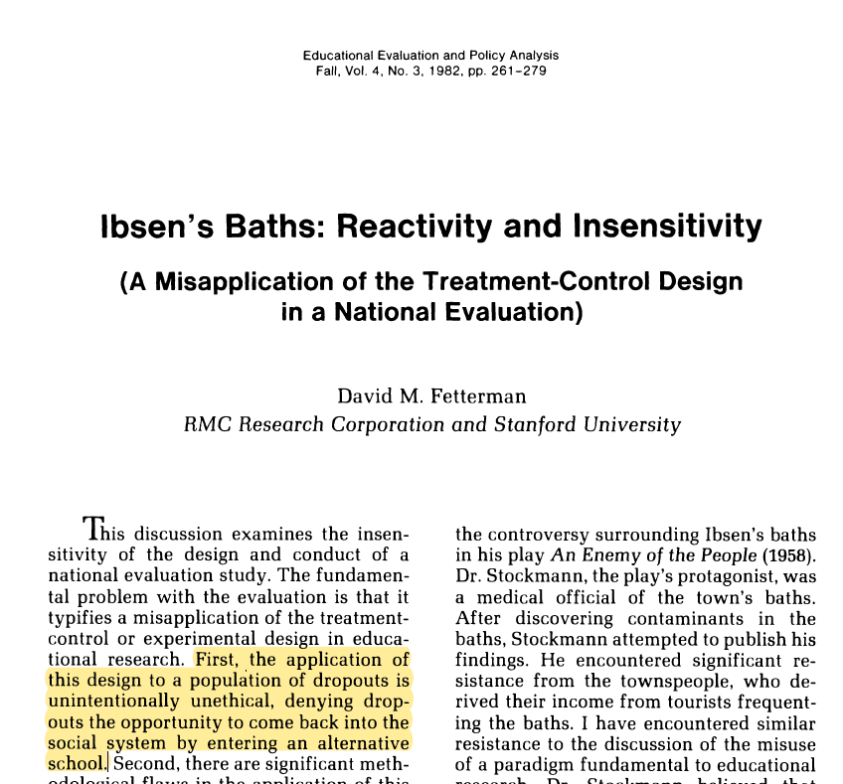
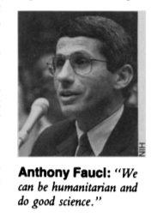
Withholding a Potentially Effective Treatment
Cons
Treatment might be being withheld from persons who need it or deserve it
“Assigning disadvantaged high school dropouts to a no-treatment control when they had expressed interest in a remedial ‘second-chance’ treatment”
Not treating patients of AIDS with promising treatments in preliminary research
Source: Marshal, E (1989)
Notes:
In Experiments, treatments are deliberately withheld from or reduced for some participants which might be ethically questionable if beneficial treatments are withheld from persons who miht neeed or deserve them.

Slide 10
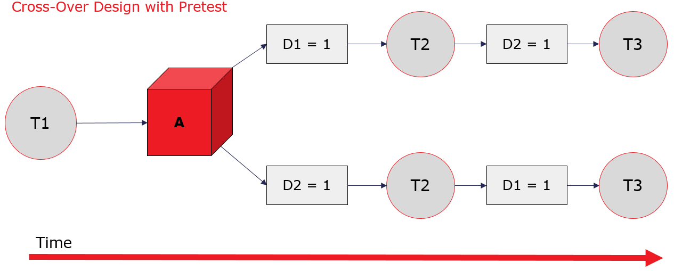
Withholding a Potentially Effective Treatment
Pros
Not found toxic side effects or long-term effects
Not selling treatments that have little effect
Efficiently using scarce resources that would not allow to treat everybody
If alternative treatments are being compared (remember Jarl’s Presentation)
Source: Steinman, I. (2022) (Session 2 slides)
Shadish et al. (2002)
Notes:
In Experiments, treatments are deliberately withheld from or reduced for some participants which might be ethically questionable if beneficial treatments are withheld from persons who miht neeed or deserve them.

Slide 11
Withholding a Potentially Effective Treatment
Useful Options When Withholding Treatment Is Problematic
Dose-Response Designs
Prior to randomization intervention
Treatment-on-Demand control
All participants receive a dose that range in their quantity/intensity
If the dose of the intervention is reduced to a certain point, the lower end is like a placebo.
Offering all participants an intervention that occurs prior to randomization so that everyone gets something
E.g., “Rockefeller Foundation’s MFSP Program”
Participants in control condition may request treatment. The researcher must decide a quantity/intensity level of treatment from which these participants must be dropped.
Shadish et al. (2002)
Notes:
Minority Female Single Parent: Provided employment training, day care and other support services to economically disadvantaged minority women who were single parents. Before randomization, all participants were invited to meetings to develop a plan to solve some of their problems in case they were assigned to the control group.

Slide 12
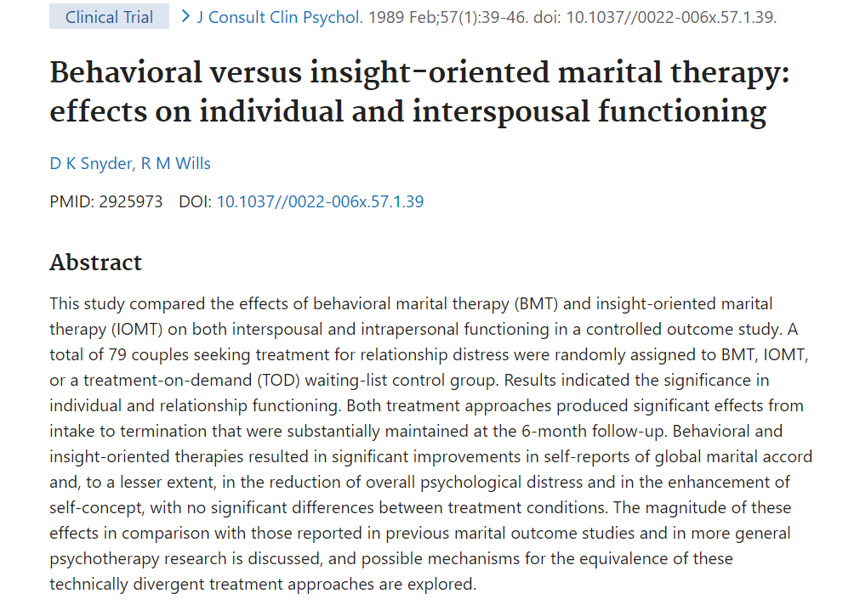
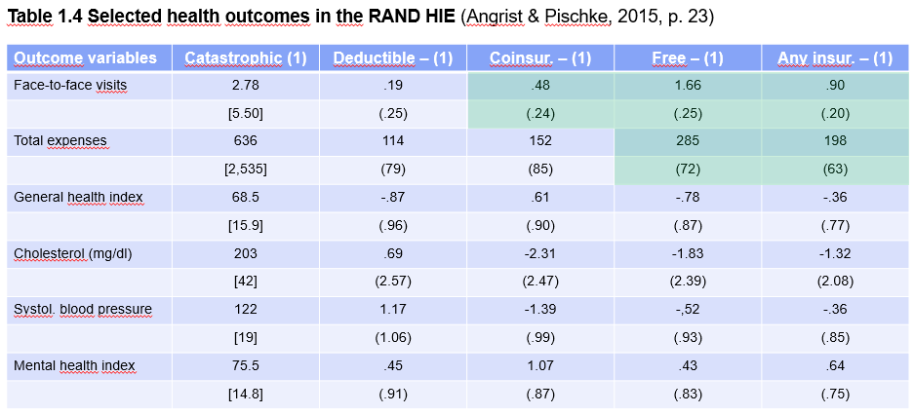
Withholding a Potentially Effective Treatment
Useful Options When Withholding Treatment Is Problematic
Dose-Response Designs
Prior to randomization intervention
Treatment-on-Demand control
All participants receive a dose that range in their quantity/intensity
If the dose of the intervention is reduced to a certain point, the lower end is like a placebo.
Offering all participants an intervention that occurs prior to randomization so that everyone gets something
E.g., “Rockefeller Foundation’s MFSP Program”
Participants in control condition may request treatment. The researcher must decide a quantity/intensity level of treatment from which these participants must be dropped.
Shadish et al. (2002)
Notes:
Minority Female Single Parent: Provided employment training, day care and other support services to economically disadvantaged minority women who were single parents. Before randomization, all participants were invited to meetings to develop a plan to solve some of their problems in case they were assigned to the control group.
Snider and Wills (1989) couples in ToD control condition could request therapeutic consultations up to 1 hour biweekly for crises that jeopardized the couple’s ability to tolerate the 3 month waiting period. Couples who requested more than 3 consultations were dropped from the study.

Slide 13
The Ethics of Randomization
“Randomized experiments make the decision by lottery, no matter what the applicants’ needs or merits, no matter whether they applied first or last, and no matter who they know or what their connections or power may be.” (Shadish et al., 2002)
“It is difficult to imagine a case in which it would be ethical to withhold [treatment from participants really need it].”
If alternative methods such as Regression Discontinuity, allow to assign treatments, e.g., a merit scholarship, on the base of the participants merits, random assignment of treatment might be considerd unethical.
Shadish et al. (2002)
Notes:
No arguments for treatment allocation according to connection or power, since it seems to violate the most basic sense of fairness.
Argument for order of application might be that those that applied first made the effort to do so, but effort is confounded with resources (knowledge, time, transportation)
Thus, the discussion focus on need and merit

Slide 14
The Ethics of Randomization
Arguments against
Arguments for
“ethical only if the conditions being compared may be therapeutically equivalent and if no better treatment exists”
Attitudes towards randomization might affect recruitment, even if resources are scarce (e.g., NIMH Collaborative Depression Project, Collins & Elkin, 1985, in Shadish et al., 2002)
Frequently researchers do not know which treatment works best because preliminary studies suffer of:
Small samples
Large sampling errors
Poorly controlled research
Low data quality
Shadish et al. (2002)

Slide 15
The Ethics of Randomization
Partial Remedies to Ethical Problems with Random Assignment
Using Regression Discontinuity to assign treatment based on need or merit
Using a “safety valve” mechanism to allow treatment for the most needed
Treating more of the most needed
Assign a bigger share of participant to the most demanded treatment
Using a dose-response design
Using an adaptive design to allow larger participation in the most successful treatment
Ensure informed-consent
Use public lotteries to increase perceived fairness
Shadish et al. (2002)

Slide 16
Recruitment Issues
Willingness and eligibility of the located potential participants is fundamental for the feasibility of an experiment
Failure to locate and recruit a willing and eligible sample of the target population will affect both construct and external validity
Challenges:
Definition of target population
Location of target population
E.g: Systolic Hypertension in the Elderly Program Experiment (Cosgrove et al., 1999)
Invitations
3.4 mil.
Volunteers/ Screened
447,921
Eligible
11,919
Randomized
4,736
Shadish et al. (2002)
Notes:
Consequences on validity?

Slide 17
Recruitment Issues
To locate participants, experimenter can use:
Preexperimental surveys to locate and characterize potential participants
Pipeline studies to follow what happens to them over time
Pilot tests to the solicitation procedures to see whowill learn about the experiment and who will attend if eligible
Trained outreach specialists skilled in communicating and generating interest about a program
Intake specialists who aggressively recruit potential participants
Efforts to learn what features of the intervention cause people to decline enrollment
Shadish et al. (2002)

Slide 18
Recruitment Issues
If the number of eligible participants is low, experimenters can:
Extend the time frame of the experiment (resources, willingness)
Intensify efforts to locate more participants (resources)
Alter eligibility requirements (validity, treatment-eligibility interactions)
Reduce number of participants assigned to treatment (power analyses)
Terminate the experiment
Shadish et al. (2002)

Slide 19
Recruitment Issues
Eligibility decisions and awareness of randomization procedures (Dunford, 1990)
Police response to misdemeanor domestic disturbance calls was randomly assigned to advice, separate or arrest
Police officers had the responsibility to judge if a case met experiment eligibility criteria
Police and city officials were concerned about lawsuits for false arrest or failure to arrest in the presence of probable cause.
How may this affect internal and externa validity of experiment results?
“Separating eligibility and recruitment judgment from assignment process would help” (Shadish et al., 2002)
Shadish et al. (2002)

Slide 20
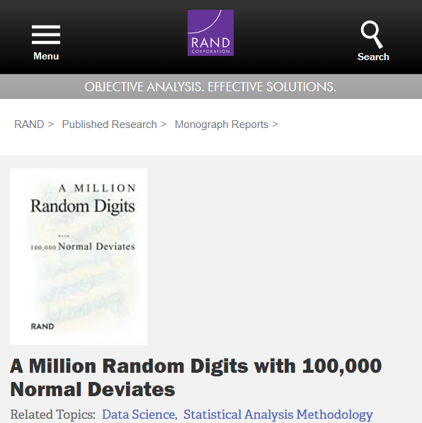
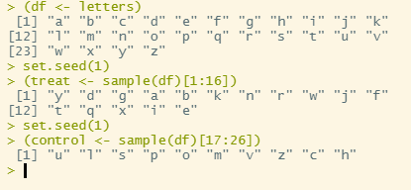
Methods of Randomization
Simple Random Assignment
Toss of a coin, roll of a die, shuffled cards, spinners, roulette wheels, urns filled with numbered balls… “When implemented properly, these easily understood and publicly transparent procedures result in perfectly good random assignments.”
Drawbacks:
Physical structure of device
Systematic behavior by experimenters
Alternatives:
Using tables of random numbers
Generate one’s own list of random numbers
Shadish et al. (2002)

Slide 21
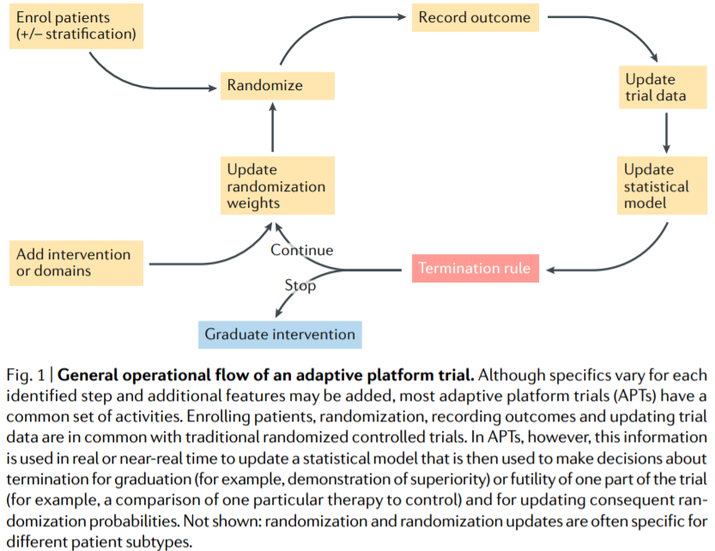
Methods of Randomization
Restricted Random Assignment to Force Equal Sample Sizes
Unequal sample sizes can complicate the estimation of effects, make the statistical analysis more sensitive to heteroscedasticity, and jeopardize power.
Researches should probably avoid simple random assignment with total sample sizes less than 200.
Methods to equalize sample sizes across conditions:
Randomize within groups
Adaptive assignment design
Start with SRA, finish assigning to planned share (problem?)
Source: Angus, D. C. et al. (2019).
Shadish et al. (2002)

Slide 22
Methods of Randomization
Restricted Random Assignment to Force Unequal Sample Sizes
Procedurally, same processes than for equal sizes
Unequal sample sizes are useful for two reasons:
Statistical: Unequal assignment of observation to conditions can increase power to detect certain effects
Practical:
Resources
Research question
Ethical reasons
Shadish et al. (2002)

Slide 23
Methods of Randomization
Batch Randomization
Trickle Randomization
Haphazard Assignment
When the experimenter cannot wait to obtain a complete list of all patients before assigning them to conditions, e.g., cancer patients.
Previously described procedures can all be adapted, but keeping track of batches is essential for later analyses of differences over batches.
When units trickle in slowly and must be assigned immediately for practical or ethical reasons, e.g., psychotherapy sessions.
Fixed proportion of units are randomly assigned to conditions based on expected proportion of treatment group.
That is, requires to have information about “trickle” process, e.g., medical study.
Not formally random, but has no obvious bias.
“Some haphazard procedures approximate random assignment reasonably well, and when [the latter] is not feasible, they may be a good choice”, e.g., using ID.
We should be aware of potential systematic differences across groups that may be generated, e.g., morning people-afternoon people.
Shadish et al. (2002)

Slide 24
Differences in Pretest Means
“we expect that the fewer the number of participants assigned to conditions, the larger are the difference in pretest means that may be found.”
Law of Large Numbers
If pretest mean differ, results have to be interpret in the light of possible intercepts
Shadish et al. (2002)

Slide 25
Differences in Pretest Means
Re-randomization
Matching and Stratifying
Matching and ANCOVA
Not ideal
“Re-randomization makes standard hypothesis testing a bit more conservative, failing to detect real effects too often.”
“Some methodologist do allow rerandomization if the criteria under which it will occur are specified in advance and if it is done prior to the start of the experiment.”
Units are matched or stratified before being randomly assigned to conditions.
Matches: same number of units and conditions, e.g., pairs of men and women
Strata: more units than conditions, e.g., participants from different areas
Caveats: matching on variables completely unrelated to outcome produces little benefit at the cost of statistical power
Good matching variable: pretest scores on outcome variable or highly correlated variable
ANCOVA is especially useful to adjust for variables that were not used for matching because their correlation with outcome was not anticipated or because it was too logistically complex to match on all variables.
Idea is to identify good control variables
More about control variables in the next session!
Shadish et al. (2002)

Slide 26
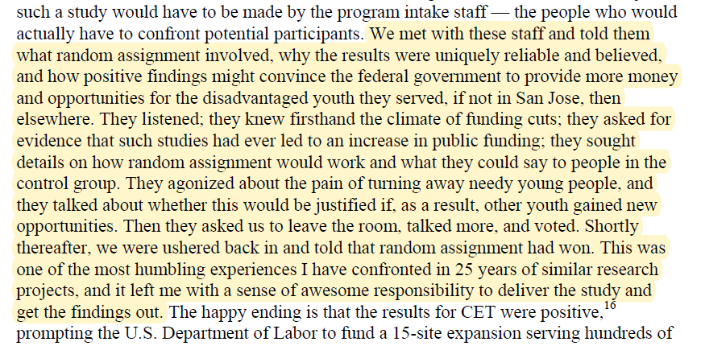
The Human Side of Random Assignment
Anecdotal evidence and research suggest to main human-driven threats to the successful implementation of random assignment procedures: a lack of planning of randomization and covert manipulation of randomization.
How to increase the likelihood of successful implementation of Random assignment (Boruch and Wothke (1985), in Shadish et al. (2002), pp. 308-311):
Plan how to explain the nature and purpose of randomization to those who will be affected, how to respond to various arguments about why randomization could or should not be done and to provide incentives for doing randomization
Shadish et al. (2002)

Slide 27
The Human Side of Random Assignment
Anecdotal evidence and research suggest to main human-driven threats to the successful implementation of random assignment procedures: a lack of planning of randomization and covert manipulation of randomization.
How to increase the likelihood of successful implementation of Random assignment (Boruch and Wothke, 1985, in Shadish et al., 2002, pp. 308-311):
Plan how to explain the nature and purpose of randomization to those who will be affected, how to respond to various arguments about why randomization could or should not be done and to provide incentives for doing randomization
Pilot test the randomization procedure to discover problems that can be remedied with further planning (e.g., undertrained or nonpartisan staff, objections to actions during randomization, etc.).
Develop clear procedures for implementation, control and monitoring for the process throughout the experiment
Shadish et al. (2002)

Slide 28
The Human Side of Random Assignment
Have meetings at which to negotiate the randomization with stakeholders. This allows:
To acquire knowledge from staff about what is most likely to go wrong
Enlist their active cooperation
Minimize costs and objections to randomization
Develop fallback option that can be used to bolster estimates of program effects in the event that randomization fails (e.g., staggered implementation of treatment over sites)
Take advantage of naturally occurring opportunities that facilitate the conduct of randomization (e.g., drawing of troops through a lottery)
Examine the match between the proposed design and factors that will make randomization more likely to be successful in the particular context of the experiment (e.g., randomizing aggregate units such as classes).
Shadish et al. (2002)

Slide 29
Take away messages
RCT might raise several ethical concerns
The benefits from RCT can only be ripped if random assignment is well conducted. Special attention must be paid to the recruitment and assignment of conditions procedures.

Slide 30
5 | Regression Models Time: 31 January 2022, 12:15 – 14:00h Main Instructor: Isa Steinmann Required Reading: Angrist & Pischke (2015), Chapter 2
6 | Further Control Strategies Time: 03 February 2022, 12:15 – 14:00h Main Instructor: Isa Steinmann Required Reading: -
7 | Instrumental Variable Approaches Time: 10 February 2022, 12:15 – 14:00h Main Instructor: José Manuel Arencibia Alemán Required Reading: Angrist & Pischke (2015), Chapter 3
8 | Regression Discontinuity Designs I Time: 07 February 2022, 12:15 – 14:00h Main Instructor: José Manuel Arencibia Alemán Required Reading: Angrist & Pischke (2015), Chapter 4

Slide 31
References
Angrist, J. D., & Pischke, J.-S. (2015). Mastering 'metrics : the path from cause to effect. Princeton University Press.
Shadish, W. R., Cook, T. D., & Campbell, D. T. (2002). Experimental and quasi-experimental designs for generalized causal inference. Houghton Mifflin.
Secondary References
Angus, D. C. et al. (2019). Adaptive platform trials: definition, design, conduct and reporting considerations The Adaptive Platform Trials Coalition. Nature reviews. Drug discovery, 18(10), 797-807. https://doi.org/10.1038/s41573-019-0034-3
Bos, J. (2020). Perspectives. In Research Ethics for Students in the Social Sciences (pp. 29-51). Springer International Publishing. https://doi.org/10.1007/978-3-030-48415-6_3
Collins, J. F., & Elkin, I. (1985). Randomization in the NIMH Treatment of Depression Collaborative Research Program. In R. F. Boruch & W. Wothke (Eds.), Randomization and field experimentation (pp. 27-37).
Fetterman, D. M. (1982). Ibsen's Baths: Reactivity and Insensitivity (A Misapplication of the Treatment-Control Design in a National Evaluation). Educational evaluation and policy analysis, 4(3), 261-279. https://doi.org/10.2307/1164057
Gueron, J. (2008). The politics of random assignment: implementing studies and impacting policy. Journal of children's services, 3(1), 14-26. https://doi.org/10.1108/17466660200800003
Marshall, E. (1989). Quick Release of AIDS Drugs. Science, 245(4916), 345-347. https://doi.org/10.1126/science.2756418
Snyder, D. K., & Wills, R. M. (1989). Behavioral Versus Insight-Oriented Marital Therapy: Effects on Individual and Interspousal Functioning. J Consult Clin Psychol, 57(1), 39-46. https://doi.org/10.1037/0022-006X.57.1.39

